Slide 1

大数据存储
胡泽瑞 2019.
huzr@nbjl.nankai.edu.cn

Slide 2

目录
大数据生态系统基础知识
文件格式及其优化
HDFS的优化

Slide 3
大数据生态系统基础知识
Hadoop生态系统
HDFS结构
MapReduce工作机制

Slide 4
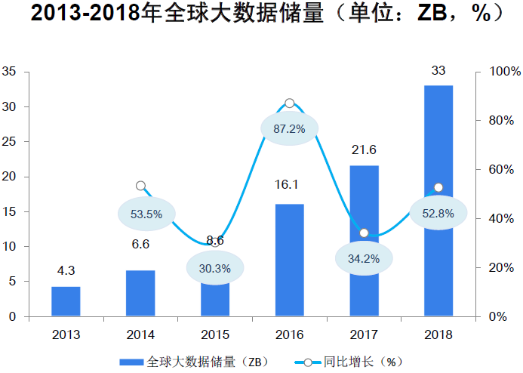
大数据时代
GB、TB、PB、EB、ZB、YB

Slide 5
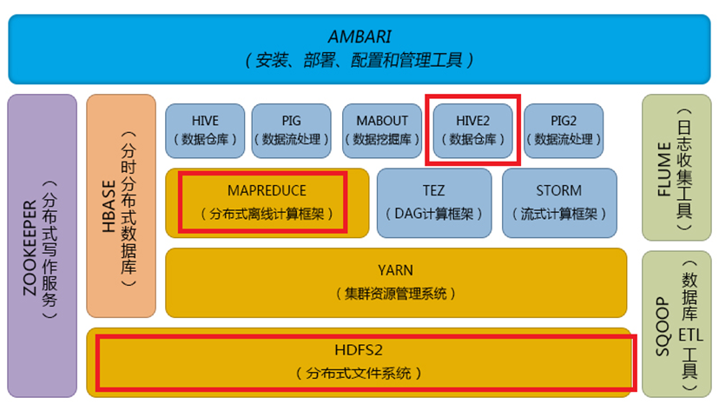
Hadoop生态系统
PB级数据的存储与计算 → Hadoop生态系统

Slide 6

狭义上的Hadoop
狭义上的Hadoop包含HDFS以及MapReduce框架
HDFS
MapReduce

Slide 7


分布式文件系统HDFS
几个关键点：
建立在单机文件系统基础上（组织者，上下级）
Master – Slave架构
以block的方式进行组织（默认128M）
高容错性（多副本策略）
HDFS Blocks
NameNode
(A part of the Master node)
Store Block 1
Store Block 2
Store Block 3
DataNode 1
DataNode 2
DataNode 3

Slide 8
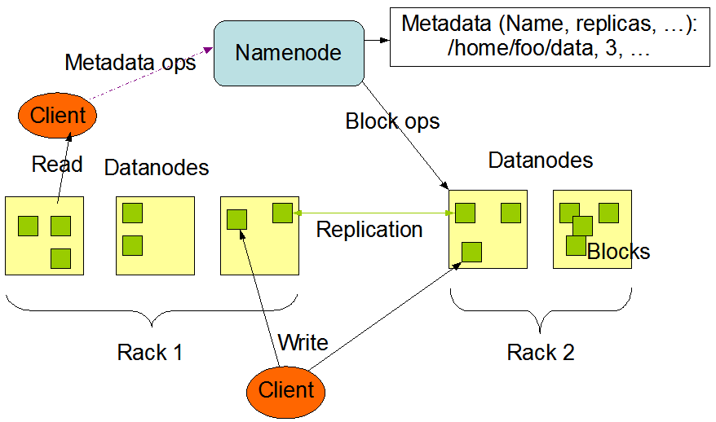
NameNode与DataNode
NameNode：
存储元数据
元数据在内存以及磁盘中
元数据是文件，block，DataNode之间的映射关系
DataNode：
存储文件内容
数据在磁盘中

Slide 9
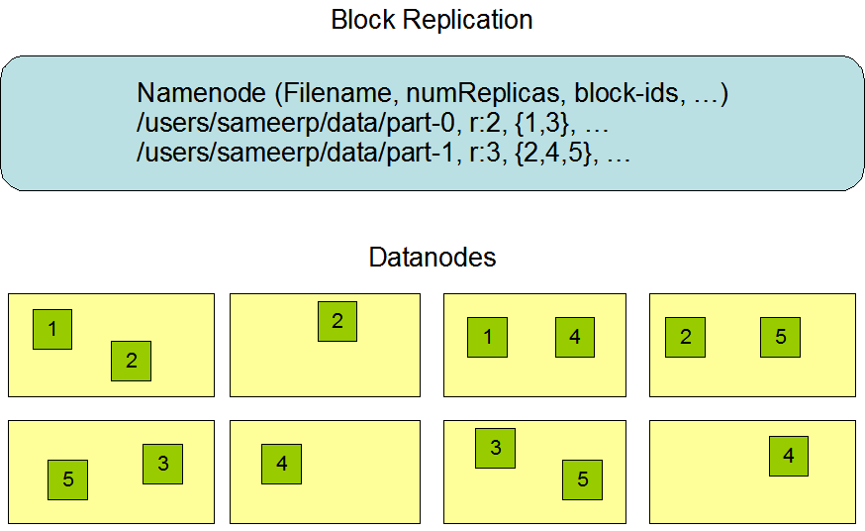
NameNode元数据
文件、目录自身的属性信息，例如文件名、目录名、目录是否存在等
文件的存储相关相关信息，例如分块情况、存储块信息、副本个数等
记录HDFS的DataNode信息,用于DataNode的管理
hadoop fs -ls /
hadoop fs -put test.txt /aa/bb/cc/
类似的还有get、mkdir、rm、copyFromLocal

Slide 10
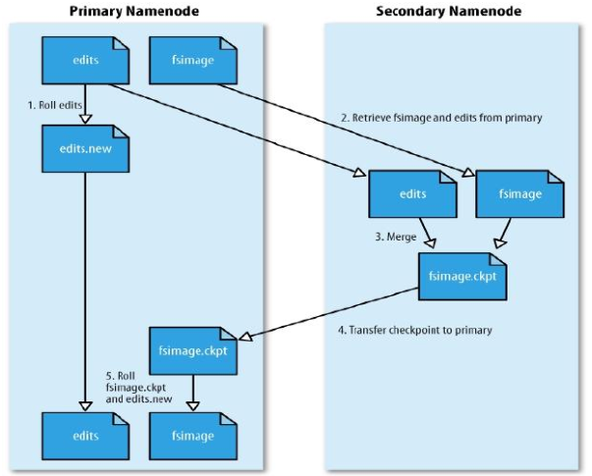
元数据存储机制
Secondary NameNode、edits、fsimage
将hdfs更新记录写到edits.new
将fsimage和edits通过http协议发送到Secondary NameNode
合并fsimage和edits
将fsimage.ckpt通过http协议发送到NameNode
重命名fsimage.ckpt为fsimage，edits.new为edits

Slide 11


计算框架——MapReduce
如果想统计过去50年毕业生毕业论文出现最多的几个单词，看看大家都在研究什么,拿收集好论文后,该怎么办呢？
方案一：写一个小程序，把所有论文按顺序遍历一遍，统计每一个遇到的单词的出现次数
方案二：写一个多线程程序，并发遍历论文，需要同步共享数据；
方案三：把作业交给多个计算机去完成——可以将方案一的程序部署到N台机器上，然后把论文集分成N份,一台机器跑一个作业。这个方法跑得足够快，但是部署起来麻烦，我们要人工把程序copy到别的机器，要人工把论文集分开，最终还要把N个运行结果进行整合。

Slide 12
MapReduce Operations on Hadoop
Get average salary of each of 2 organizations in a huge file.
{name: (org., salary)}
{org.: avg. salary}
Key
Value
Key
Value
Original key/value pairs: all the person names associated with each org name and their salaries
Result key/value pairs: two entries showing the org name and corresponding average salary
Name | (dept. ,salary)
Alice | (Org-1, 3000)
Bob | (Org-2, 3500)
dept. | avg. salary
Org-1 | …
Org-2 | …
…
……

Slide 13
MapReduce Operations on Hadoop
Calculate the average salary of every organization
{name: (org., salary)}
{org.: avg. salary}
HDFS
A HDFS block
Hadoop Distributed File System (HDFS)

Slide 14
MapReduce Operations on Hadoop
Calculate the average salary of every department
{name: (org., salary)}
{org.: avg. salary}
HDFS
Map
Map
Map
Each map task takes 4 HDFS blocks as its input and extract {org.: salary} as new key/value pairs, e.g. {Alice: (org-1, 3000)} to {org-1: 3000}
3 Map tasks concurrently process input data
Records of “org-1”
Records of “org-2”

Slide 15
MapReduce Operations on Hadoop
Calculate the average salary of every department
{name: (org., salary)}
{org.: avg. salary}
HDFS
Map
Map
Map
Shuffle the data using org. as Partition Key (PK)
Records of “org-1”
Records of “org-2”

Slide 16
MapReduce Operations on Hadoop
Calculate the average salary of every department
{name: (org., salary)}
{org.: avg. salary}
HDFS
Map
Map
Map
Calculate the average salary for “org-1”
Calculate the average salary for “org-2”
Reduce (Avg.)
Reduce (Avg.)
HDFS
Notes:
2 Reduce tasks concurrently perform aggregation on the data of each department and then generate the final output to HDFS

Slide 17
Key/Value Pairs in MapReduce
A simple but effective programming model designed to process huge volumes of data concurrently on a cluster
Map: (k1, v1) → (k2, v2),
e.g. (name, org & salary) → (org, salary)
Reduce: (k2, v2) → (k3, v3),
e.g. (org, salary) → (org, avg. salary)
Shuffle: Partition Key (It could be the same as k2, or not)
Partition Key: to determine how a key/value pair in the map output be transferred to a reduce task
e.g. org. name is used to partition the map output file accordingly
Notes:
MapReduce programming model and its implementation has been proven to be a very important framework to deal with Big Data. MapReduce is a simple but effective programming model designed to process huge volumes of data concurrently on a cluster. A data processing procedure is composed by one or multiple MR jobs. In every MR job, data is organized as key/value pairs. For example, we can have a kind of key/value pair with name of a person as key and the age of him or her as value. Typically, a mr job has two parts, a map function and a reduce function. These two functions will transform a key/value pair to another kind of key/value pair. These two functions are invoked by map and reduce tasks, respectively. Right now, Hadoop is the most widely used implementation of MapReduce. Hundreds of society-dependent corporations/organizations have chosen hadoop and its ecosystem as their big data analytics platform, such as Facebook, IBM, NY Times, Yahoo! ….

Slide 18


MR(Hadoop) Job Execution Patterns
MR program (job)
The execution of a MR job involves 6 steps
Map Tasks
Reduce Tasks
Control level work, e.g. job scheduling and task assignment
Data is stored in a Distributed File System (e.g. Hadoop Distributed File System)
1: Job submission
Master node
Worker nodes
Worker nodes
2: Assign Tasks
Do data processing work specified by Map or Reduce Function
Notes:
Let’s quickly review the execution of a MapReduce job, or be specific Hadoop Job. In a Hadoop cluster, there is master node, which will take care all of control level work, such as job scheduling and task assignment. There are a bunch of worker nodes, which will do data processing work specified by Map or Reduce function. In the cluster, data is stored in a distributed file system, in hadoop, it is hadoop distributed file system. The execution of a MR job has 6 steps. Firstly, a user will submit his or her MR program, or called MR job. Then, when this job is ready to be executed, the master will assign map and reduce tasks to worker nodes.

Slide 19
MR(Hadoop) Job Execution Patterns
MR program
The execution of a MR job involves 6 steps
Map Tasks
Reduce Tasks
1: Job submission
Map output
Master node
Worker nodes
Worker nodes
Map output will be shuffled to different reduce tasks based on Partition Keys (PKs) (usually Map output keys)
3: Map phase
Concurrent tasks
4: Shuffle phase

Slide 20
MR(Hadoop) Job Execution Patterns
MR program
The execution of a MR job involves 6 steps
Map Tasks
Reduce Tasks
1: Job submission
6: Output will be stored back to Distributed File System
Master node
Worker nodes
Worker nodes
Reduce output
3: Map phase
Concurrent tasks
4: Shuffle phase
5: Reduce phase
Concurrent tasks
Notes:
There are three phases in the job execution. First one is map phase, in this phase, the worker nodes associated with map tasks will concurrently process the input data and generate intermediate key/value pairs. Then, in the shuffle phase, the intermediate results will be distributed to worker nodes associated with reduce tasks. All key/value pairs with same key will be distributed to the same reduce tasks. After that, the worker nodes associated with reduce tasks will concurrently process the intermediate key/value pairs and generate the results of this job. Finally, the output will be stored back to HDFS.

Slide 21
MR(Hadoop) Job Execution Patterns
MR program
The execution of a MR job involves 6 steps
Map Tasks
Reduce Tasks
1: Job submission
6: Output will be stored back to Distributed File System
Master node
Worker nodes
Worker nodes
A MapReduce (MR) job is resource-consuming:
1: Input data scan in the Map phase => local or remote I/Os
2: Store intermediate results of Map output => local I/Os
3: Transfer data across in the Shuffle phase => network costs
4: Store final results of this MR job => local I/Os + network costs (replicate data)
Reduce output
3: Map phase
Concurrent tasks
4: Shuffle phase
5: Reduce phase
Concurrent tasks
Notes:
Although mapreduce programming model hide the complex parallel programming work, programmers should know a MR job is resources consuming. There are three kinds of nontrivial costs. First is the job-scheduling and task-startup costs. Second is the network transfer in the shuffle phase. Finally, the third one is the potential costs on remotely access map input data once a map task is not co-located with its input data.

Slide 22
文件格式及其优化
RC File/ORC
压缩背景知识
Parquet

Slide 23
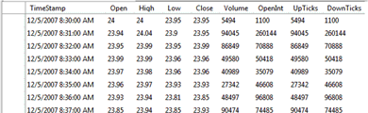
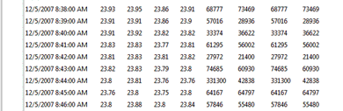
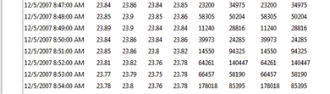
Data Format: how to place a table to a cluster
How to store a table over a cluster of servers ?
answer = table placement method
Server 1
Server 2
Server 3
Notes:
narrow down the scope
big data analytics -> sql-like
big data -> 2-dimensional table in relational db (arbitrary # rows, fixed # columns)
the storage end consists of a cluster of servers
question -> how should we divide and distribute the data to each server, and how we organize them on each local disk
we call each answer to this question, a table placement method

Slide 24
Existing Data Placement Methods
Row-Store: partitioning a table by rows to store
Merit 1: fast data loading
Merit 2: all columns in a row are in one HDFS block
Limit 1: not all columns to be used (unnecessary I/O)
Limit 2: row-based data compression may not be efficient
Column-Store: partitioning a table by columns to store
Merit 1: only read the useful columns (I/O efficient)
Merit 2: Efficient compression under the same data type
Limit 1: Column grouping need intra-network communication
Limit 2: Column partitioning operations can be an overhead

Slide 25
RCFile (Record Columnar File) in Hive
Minimizing unnecessary I/Os like Column-store
Only read needed columns from disks
Minimizing network communication like Row-store
Minimizing column grouping operations
Keep the fast data loading speed of Row-store
Efficient data compression like Column-store
Goal: to minimize the limits of Row-store and Column-store under HDFS
Notes:
Needs hints to take advantage of row-stores, column stores, and compression.

Slide 26
RCFile: Partition Table into Row Groups
A HDFS block consists of one
or multiple row groups
Table
A
…
B
…
C
…
D
…
HDFS Blocks
Store Block 1
Store Block 2
Store Block 3
Store Block 4
…
A Row Group
101
102
103
104
105
201
202
203
204
205
301
302
303
304
305
401
402
403
404
405
…
…
…
…
Notes:
Consistent format to the previous presentations of row-store and column-store

Slide 27
RCFile: Distributed Row-Groups among Nodes
For example, each HDFS block has three row groups
HDFS Blocks
NameNode
Store Block 1
Store Block 2
Store Block 3
Row Group 1-3
Row Group 4-6
Row Group 7-9
DataNode 1
DataNode 2
DataNode 3
Notes:
So far it looks as same as the row-store
Now I will show you the difference

Slide 28

Inside each Row Group
Metadata
Store Block 1
101
102
103
104
105
201
202
203
204
205
301
302
303
304
305
401
402
403
404
405
Notes:
No duplication

Slide 29
RCFile: Inside each Row Group
Compressed Metadata
Compressed Column A
Compressed Column B
Compressed Column C
Compressed Column D
101
102
103
104
105
101 | 102 | 103 | 104 | 105
201
202
203
204
205
301
302
303
304
305
201 | 202 | 203 | 204 | 205
401
402
403
404
405
301 | 302 | 303 | 304 | 305
401 | 402 | 403 | 404 | 405
Notes:
No duplication

Slide 30
An optimal spot can be determined by balancing row-store and column-store
Unnecessary I/O transfers
(MBytes)
Row-store
RCFile: Combined row-stores and column-store
Column-store
The function curve depends on the ways of table partitioning in rows and columns, and access patterns of workloads.
Unnecessary network transfers
(MBytes)
Notes:
http://www.dbms2.com/2009/05/11/facebook-hadoop-and-hive/

Slide 31
压缩算法分类
有损压缩（放弃了很多必要数据的存储、不可能被还原）
字典编码（LZ77、LZ78、LZW等）
无损压缩
熵编码（eg. Huffman coding、Arithmetic coding）
无字典编码
游程编码
建模预测编码

Slide 32

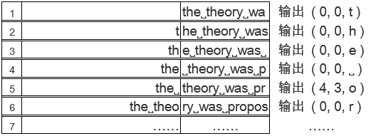
字典编码LZ77-滑动窗机制
三元组（偏移量off，匹配长度length，下个字符c）
解压过程就是不断地读取三元组并还原的过程

Slide 33
字典编码LZ78-字符串字典机制
以“the˽theory˽was˽proposed˽by˽1949”为例
编码器输出二元组（字典中匹配字符串的位置信息，新字符串之后的第一个字符）
索引 | 0 | 1 | 2 | 3 | 4 | 5 | 6 | 7
字典项 | NULL | t | h | e | ˽ | th | eo | r
输出 |  | (0,t) | (0,h) | (0,e) | (0, ˽) | (1,h) | (3,o) | (0,r)
8 | 9 | 10 | 11 | 12 | 13 | 14 | 15 | 16
y | ˽w | a | s | ˽p | ro | p | o | se
(0,y) | (4,w) | (0,a) | (0,s) | (4,p) | (7,o) | (0,p) | (0,o) | (11,e)

Slide 34
lz系列算法对比
lz系列算法中最常用的最具代表性的有：Gzip、Snappy、lz4
压缩速度
压缩率
压缩算法 | 压缩速度 | 解压速度 | 压缩率
Memcpy | 8657 MB/s | 8891 MB/s | 1
Gzip | 66 MB/s | 250 MB/s | 0.36
Snappy | 327 MB/s | 1075 MB/s | 0.48
lz4 | 785 MB/s | 2601 MB/s | 0.62

Slide 35
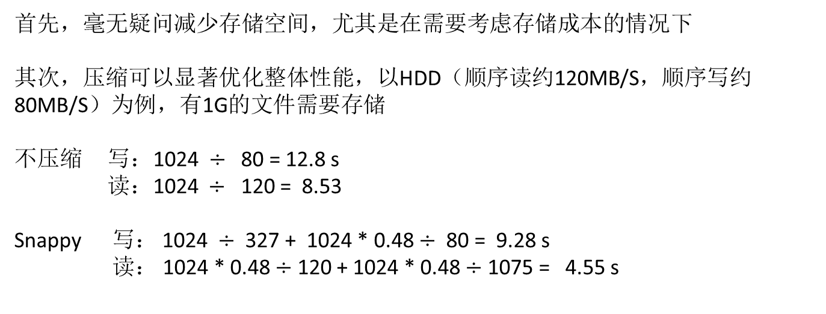
为什么压缩？
首先，毫无疑问减少存储空间，尤其是在需要考虑存储成本的情况下
其次，压缩可以显著优化整体性能，以HDD（顺序读约120MB/S，顺序写约80MB/S）为例，有1G的文件需要存储
不压缩 写：1024 $÷$ 80 = 12.8 s
读：1024 $÷$ 120 = 8.53
Snappy 写： 1024 $÷$ 327 + 1024 * 0.48 $÷$ 80 = 9.28 s
读： 1024 * 0.48 $÷$ 120 + 1024 * 0.48 $÷$ 1075 = 4.55 s
写减少了27.5%，读减少了46.7% ！ CPU换IO

Slide 36

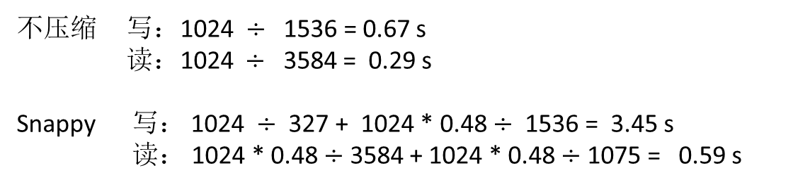
快速设备对传统方案的冲击
顺序读带宽能达到3~4GB/s
顺序写带宽能达到1~2GB/s
不压缩 写：1024 $÷$ 1536 = 0.67 s
读：1024 $÷$ 3584 = 0.29 s
Snappy 写： 1024 $÷$ 327 + 1024 * 0.48 $÷$ 1536 = 3.45 s
读： 1024 * 0.48 $÷$ 3584 + 1024 * 0.48 $÷$ 1075 = 0.59 s
整体性能反而下降！

Slide 37
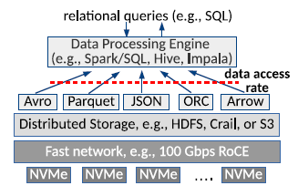
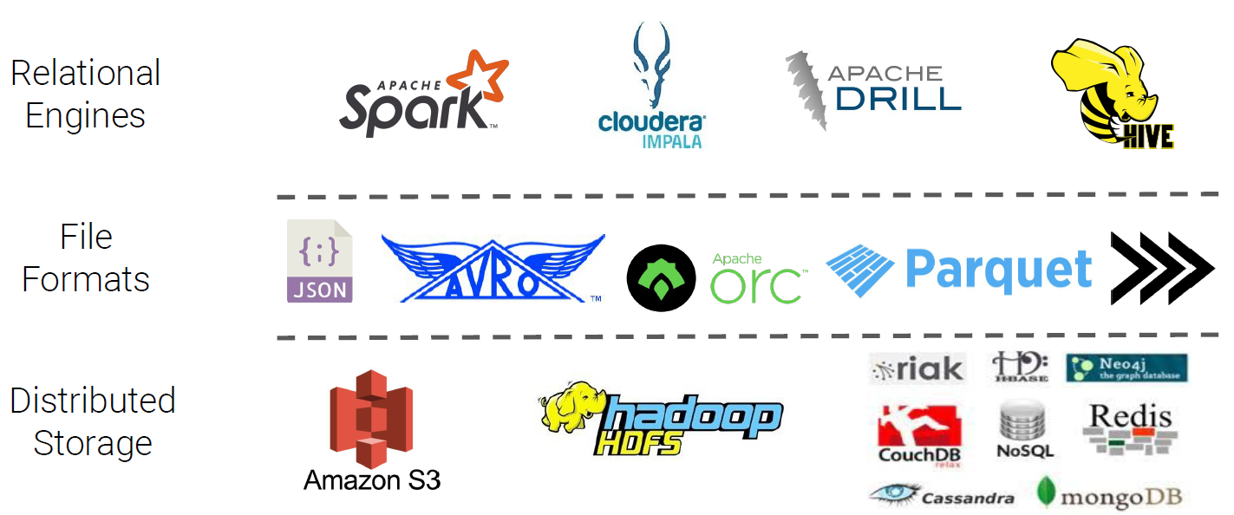
大数据文件格式的体现
12.5GB/s

Slide 38
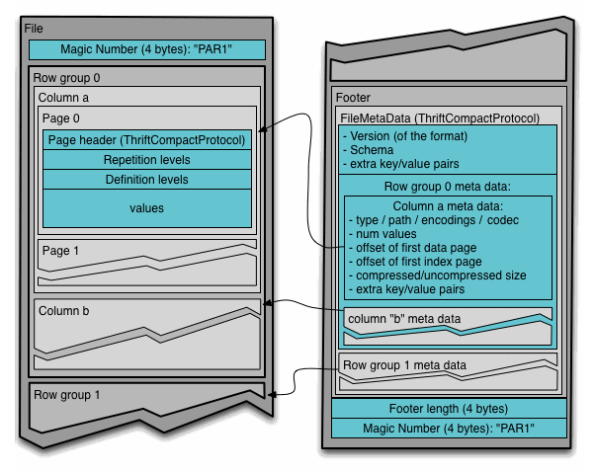
Parquet: 行存储与列存储的平衡

Slide 39
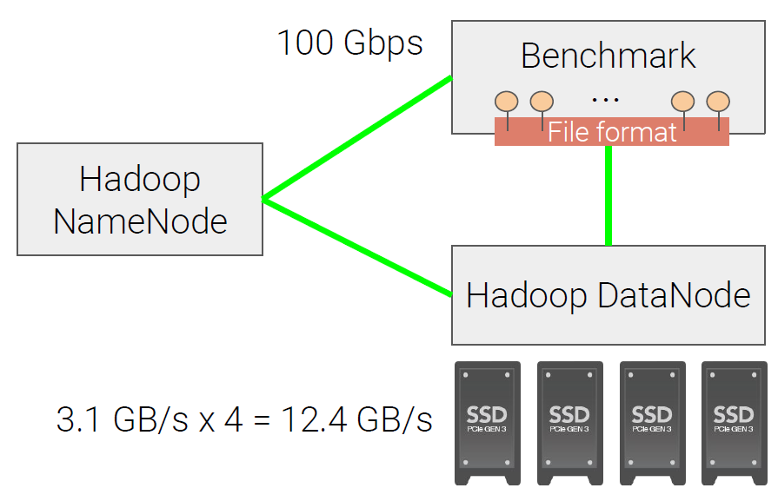
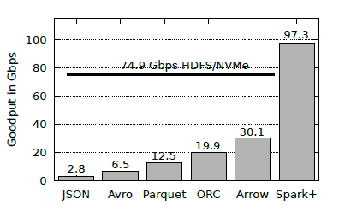
大数据文件格式的体现
完全发挥不出硬件的性能！
CPU Bound！(compression, encoding)

Slide 40
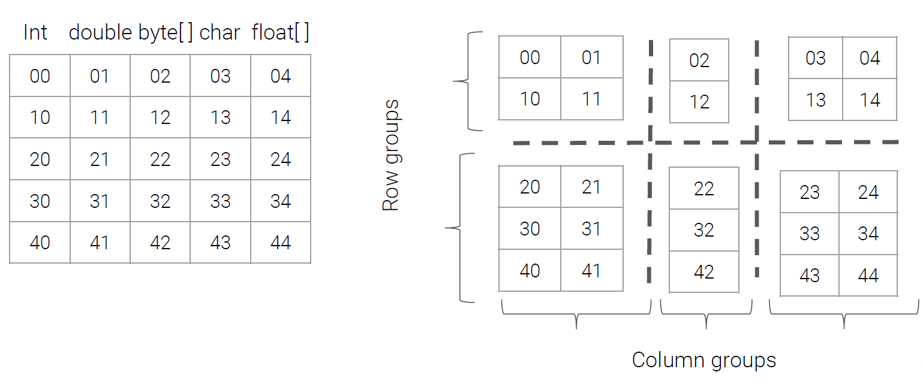
Albis—发挥硬件性能
Animesh Trivedi针对这种情况提出了新的文件格式——Albis，取消了数据压缩，充分发挥硬件的性能，进而减少整体的处理时间。

Slide 41
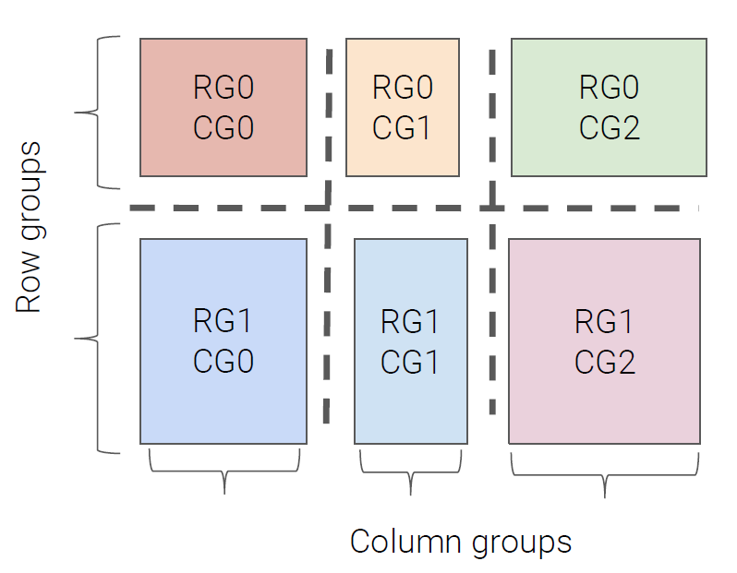
Albis—发挥硬件性能
If there is only 1 column group : Row store
If there are ‘n’ column groups : Columns store

Slide 42
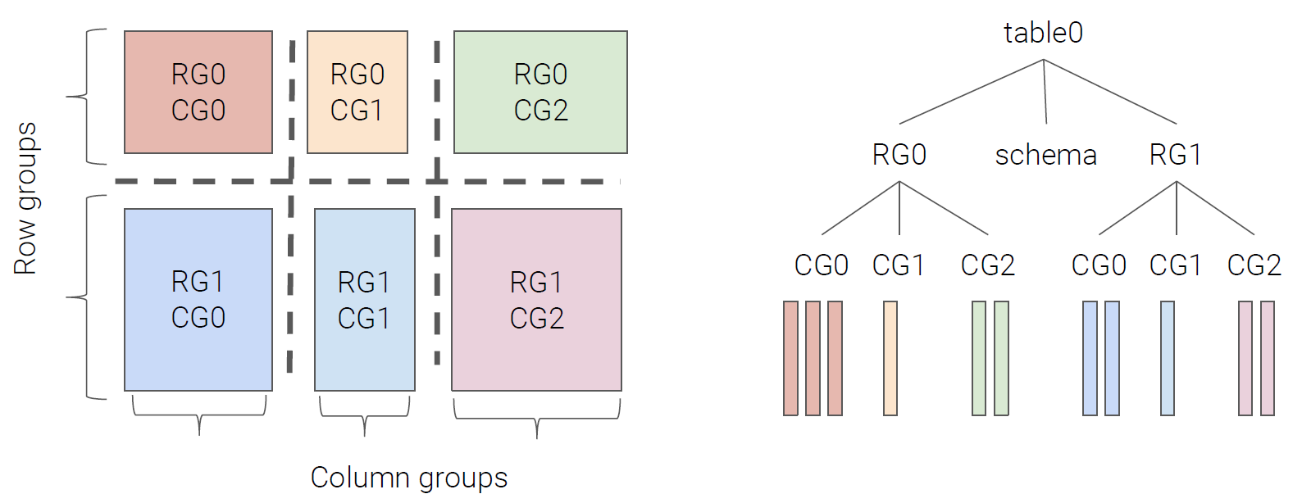
Albis—发挥硬件性能
back

Slide 43
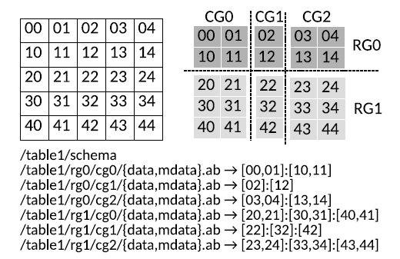
Albis—发挥硬件性能

Slide 44
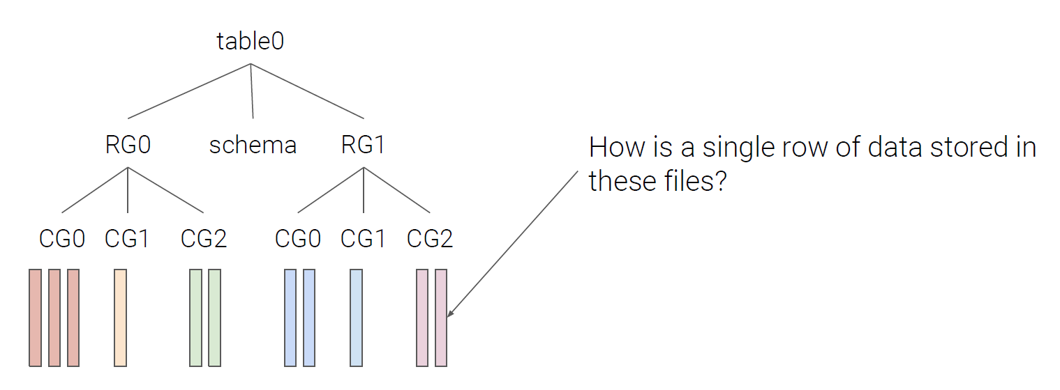
Albis—发挥硬件性能

Slide 45
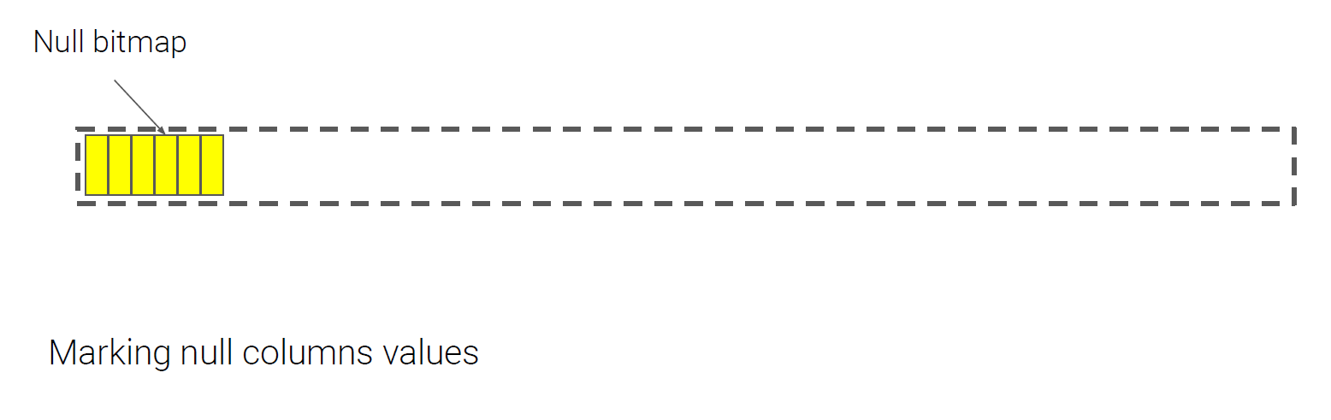
Albis—发挥硬件性能

Slide 46
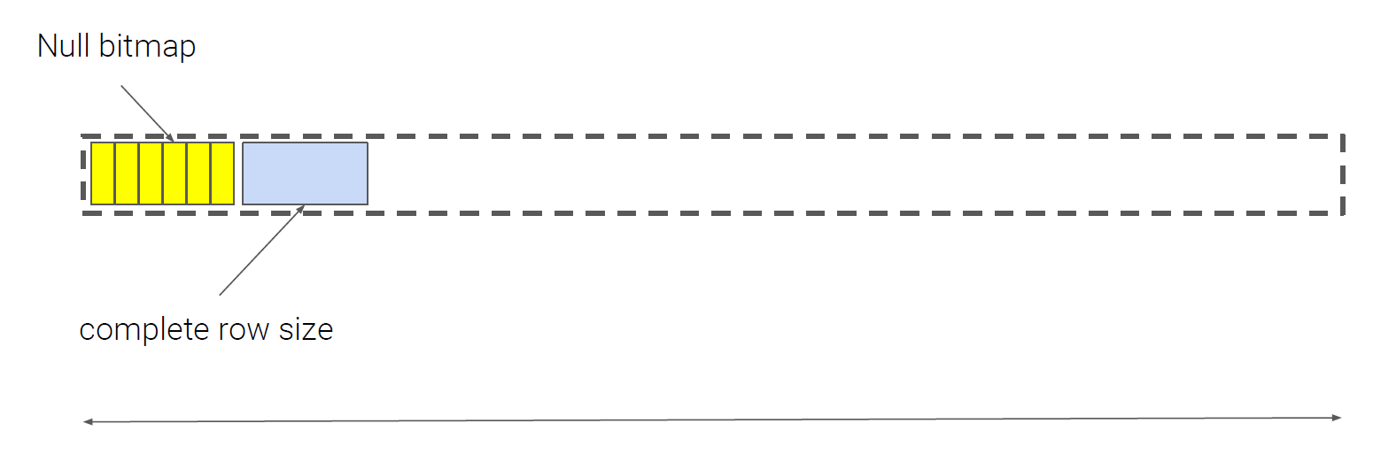
Albis—发挥硬件性能

Slide 47
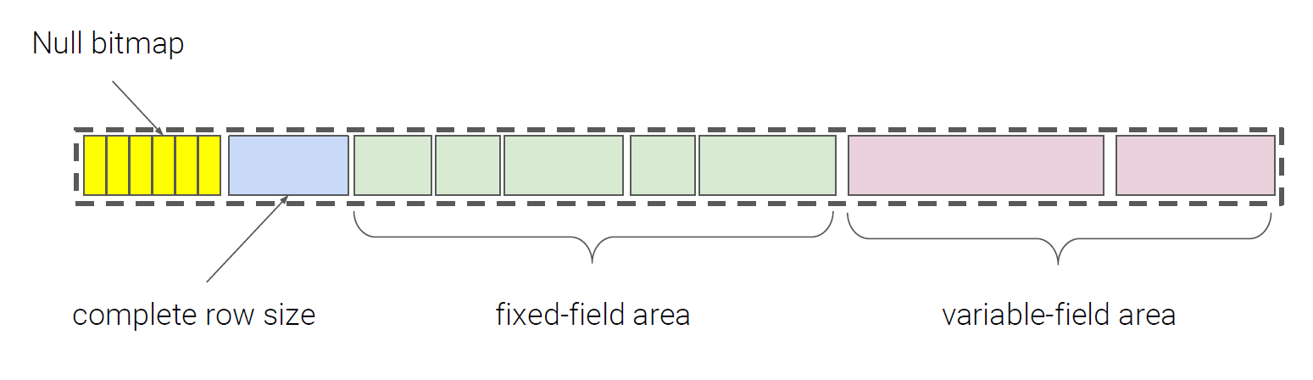
Albis—发挥硬件性能

Slide 48
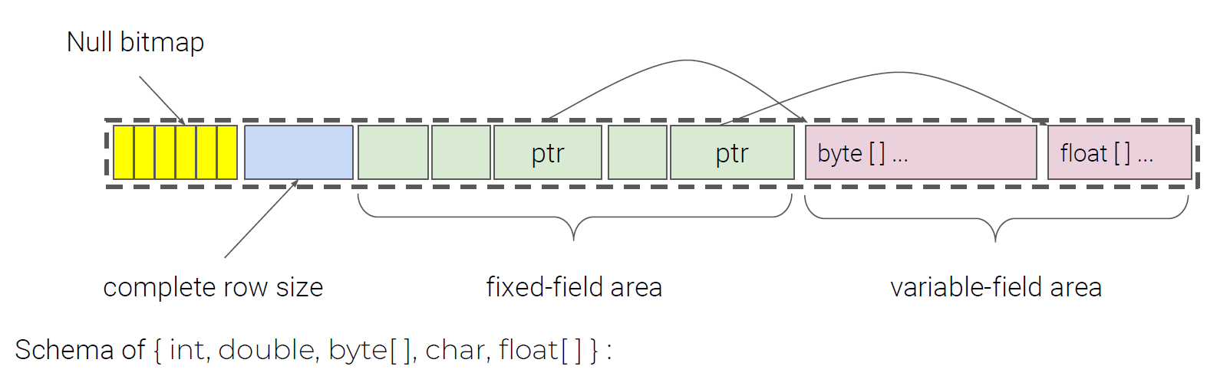
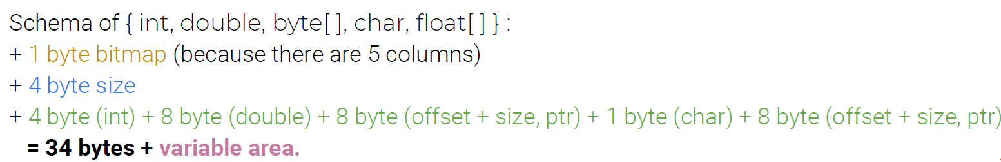
Albis—发挥硬件性能

Slide 49
Albis—发挥硬件性能
Albis的优势：
快设备不压缩本身带来的优势，如前面分析；
减小了“读放大” ORC Albis
直接采用二进制API操作

Slide 50
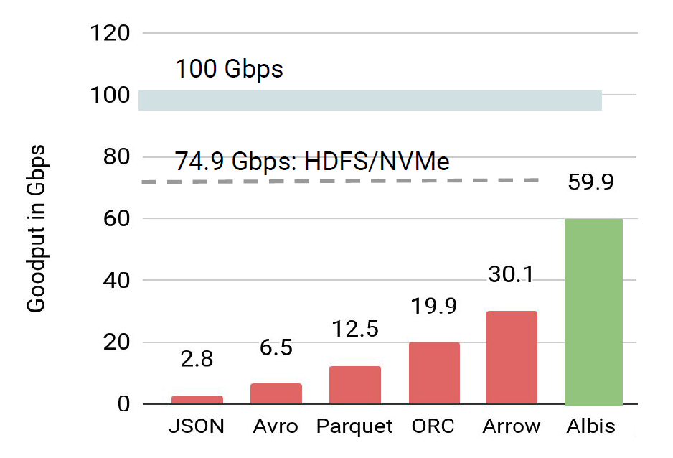
Albis—发挥硬件性能
Trade storage space for performance

Slide 51
NVM优化HDFS

Slide 52
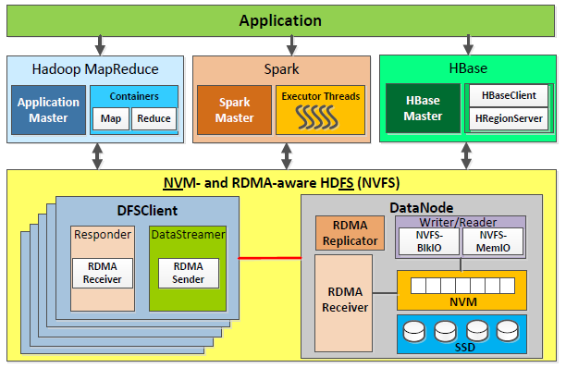
NVFS——ICS’16
Nusrat Sharmin Islam等人提出基于NVM的HDFS——NVFS

Slide 53
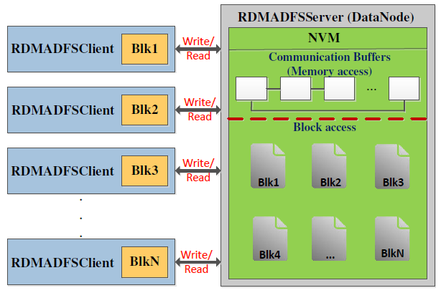
NVFS—BlkIO
RDMA communication: buffers allocated from NVM
Block files created in NVM using the HDFS file system APIs
JAVA I/O streams

Slide 54
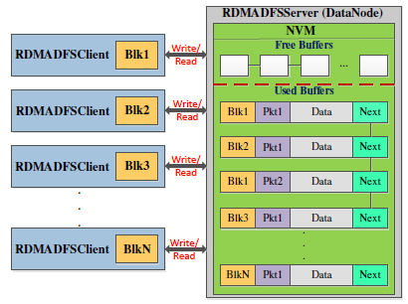
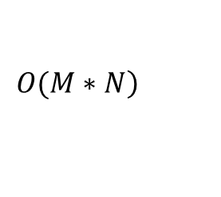
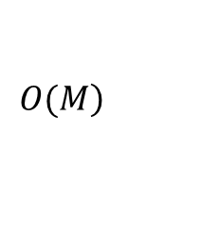
NVFS-MemIO
A pool of buffers
Head pointer、tail pointer
A blk consists of several pkts
Block id、packet sequence number
Shared buffers for communication
The first free buffer pointed to by tail act as the RDMA receive buffer
Overlap between Reader and Writer
Scan through the buffer pool during read
Flat architecture
Read:
Write:
$$\left.Ο(M∗N\right)$$
$$\left.Ο(M\right)$$

Slide 55
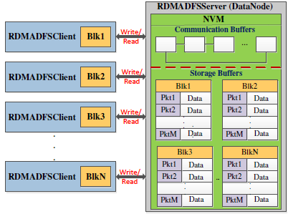
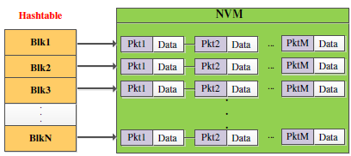
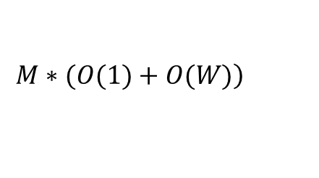
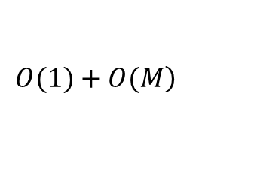
NVFS-MemIO
Two different buffer pools
Re-usable communication buffers
HDFS Block Structure through the storage buffers
Overlapping between communication and storage
Constant time retrieval of blocks during read
Synchronization
block architecture
Read:
Write:
$$\left.Ο(1)+Ο(M\right)$$
$$\left.M∗(Ο(1)+Ο(W)\right)$$

Slide 56
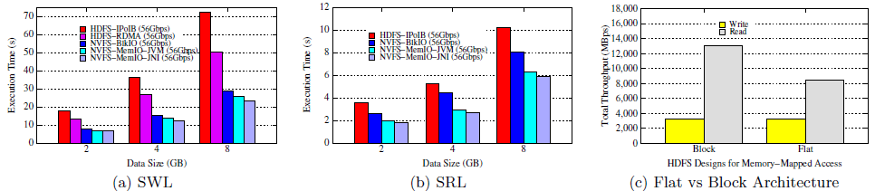
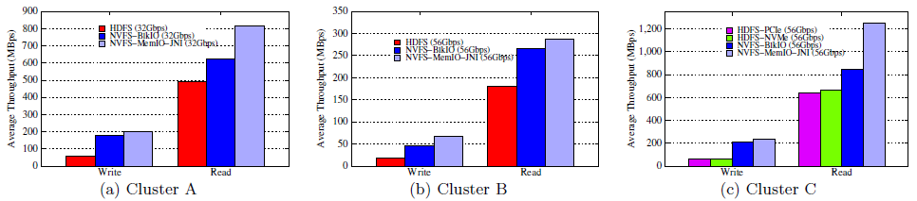
NVFS
HDFS Benchmark
TestDFSIO

Slide 57
参考
[1] Yongqiang He, Rubao Lee, Xiaodong Zhang, RCFile: A Fast and space-efficient data placement structure in MapReduce-based warehouse systems, ICDE’2011
[2] 2019年中国大数据行业研究报告，https://bg.qianzhan.com/report/detail/1911111127214509.html
[3] HDFS Architecture，https://hadoop.apache.org/docs/stable/hadoop-project-dist/hadoop-hdfs/HdfsDesign.html
[4] Nusrat Sharmin Islam, Md. Wasi-ur-Rahman, Xiaoyi Liu, High Perfomance Design for HDFS with Byte-Addressability of NVM and RDMA, ICS’2016

Slide 58
Thanks! Q&A

